Slide 1
AR Day Activity Instructions

Slide 2
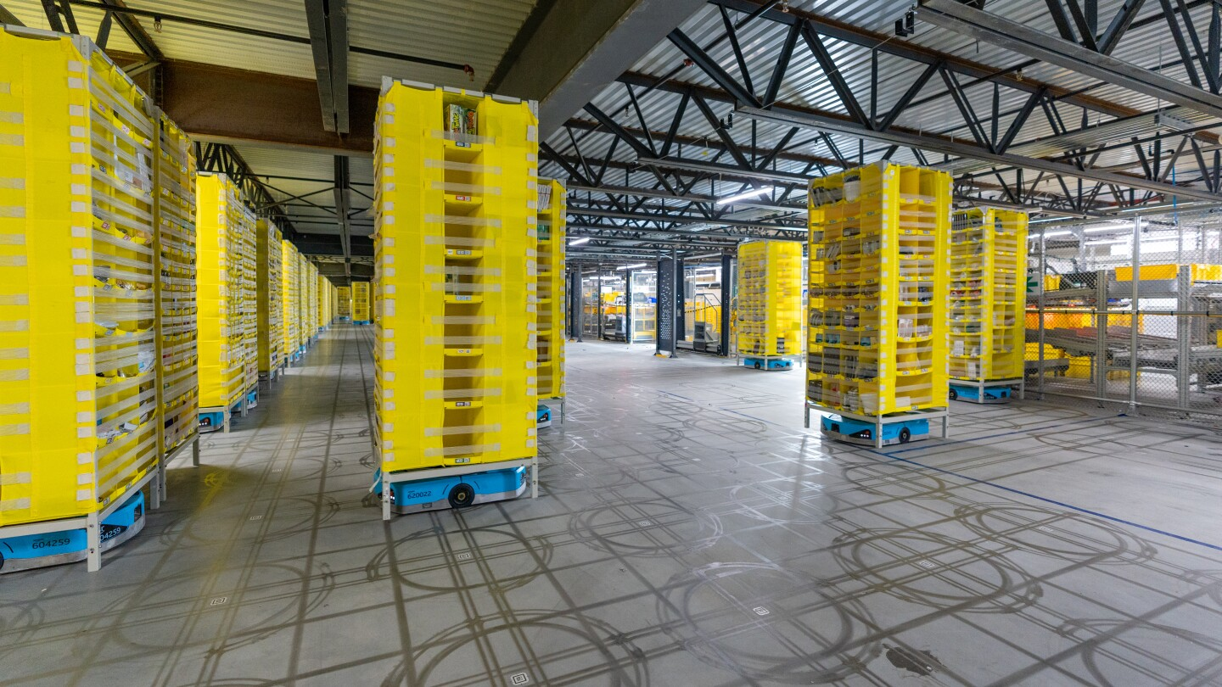
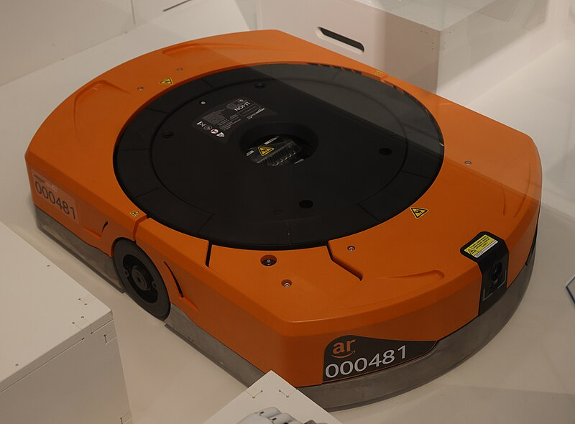
Summary
You will be writing code to control a robot in an AR Field
The player robot is orange and AI robots are blue
Player
AR Field
https://en.wikipedia.org/wiki/File:Amazon_warehouse_robot_2020.JPG
https://www.amazon.science/latest-news/amazon-robotics-autonomous-drive-units-hercules-pegasus-xanthus-xbot

Slide 3
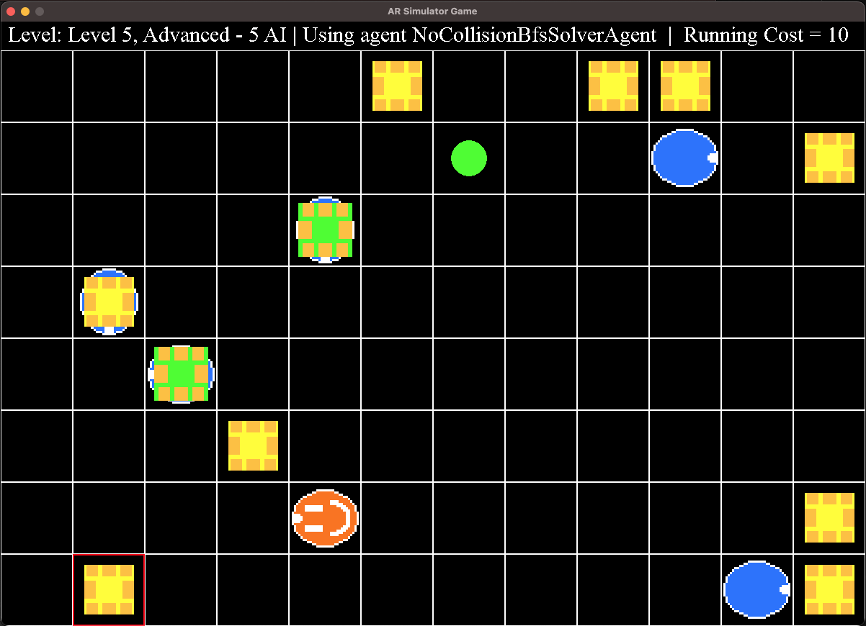
AR Objects Overview
This game is modeled after an AR field
Summary video: https://www.youtube.com/watch?v=jBQxLwhSSOw
https://en.wikipedia.org/wiki/File:Amazon_warehouse_robot_2020.JPG
https://www.amazon.science/latest-news/amazon-robotics-autonomous-drive-units-hercules-pegasus-xanthus-xbot
Notes:
So for those of you who here for the tech talk this morning, you probably have a good idea of what each of these components are, but I just have a quick video to show what happens in an AR warehouse

Slide 4
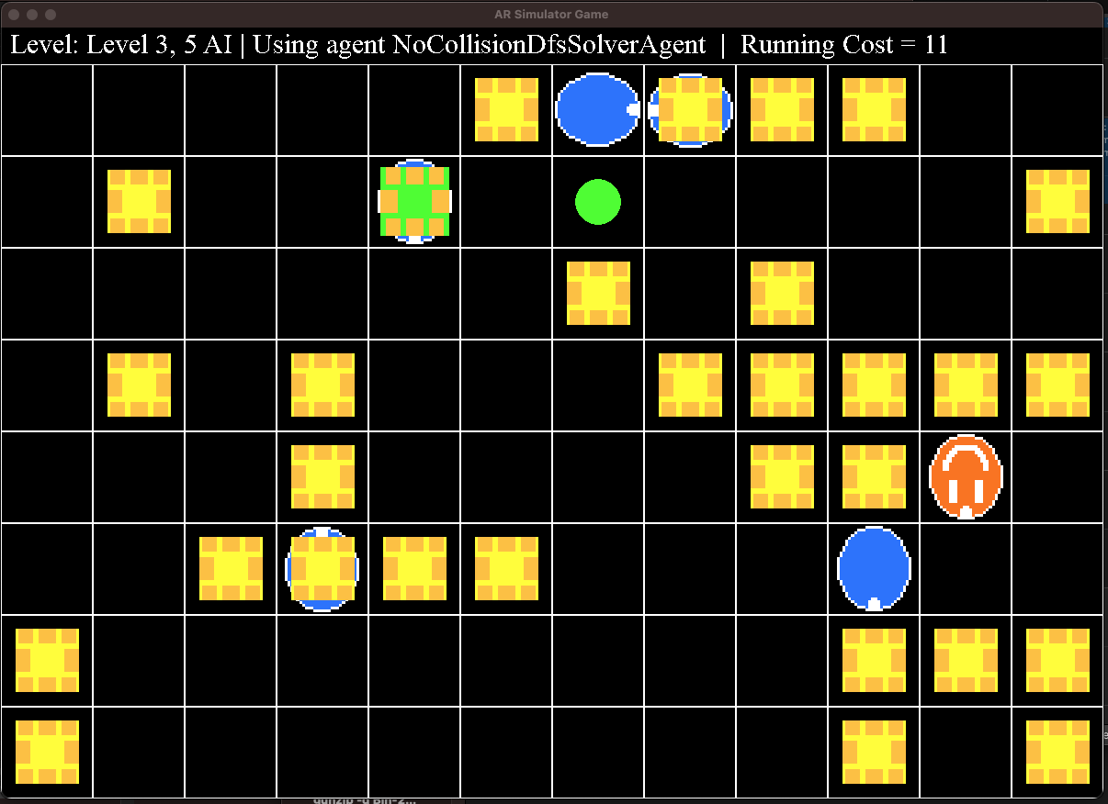
Game Goal
The primary objective is to get the player robot to the correct goal location which is the goal location closest to the player.
First 4 levels of the game
Goal Location
AI Drive carrying Pod
Idle Pod
Player Drive
AI Drive

Slide 5
AI Logic
The AI will move randomly and a new random seed will be used for the final competition
[TIP] Test your code using different random seeds (set in main.py)
Goal Location
AI Drive carrying Pod
Idle Pod
Player Drive
AI Drive

Slide 6
Advanced Mode
In the final level of the game (Advanced Mode), the player needs to locate a target pod, pick it up, and bring it to the closest goal location
Closest Goal Location
Target Pod (Red Outline)
Player Drive

Slide 7
Game Interaction with Player
Game Orchestrator
init_player(id, is_level_advanced_mode)
init_ai()
while game not ended:
move=player.get_next_move(sensor_data)
move_player(move)
move_all_drives()
check_endgame_conditions()
Player Class
__init__(id, is_level_advanced_mode):
# your logic
get_next_move(sensor_data):
move = # your logic
return DriveMove.move
Rules:
You can only modify the player agent file – all other files will be taken from the remote repo for the competition
Your player moves first each turn
AI Drives will not crash into anything (safe to assume they won’t run into the player)
Game ends if player exits the field, crashes into another drive, max turn limit is exceeded (1000). If the player drive is not carrying a pod, it can drive under other pods
(Advanced Mode) – If player drive is carrying a pod, it can no longer drive under other pods

Slide 8
Game Controls
You can control the robot by returning a value from a set of moves
Moves are defined in the src.Constants.DriveMove enum:
Possible moves are:
DriveMove.NONE – Do nothing
DriveMove.UP – Move 1 tile up (positive y direction)
DriveMove.DOWN – Move 1 tile down (negative y direction)
DriveMove.RIGHT – Move 1 tile right (positive x direction)
DriveMove.LEFT – Move 1 tile left (negative x direction)
(Advanced mode only)
DriveMove.LIFT_POD – If a pod is in the same tile, pick it up The pod will now move with the drive until it is dropped
DriveMove.DROP_POD – If a pod is in the same tile, drop it The pod will now stay in this position until it is picked up

Slide 9
Player Sensor Data
Each turn you will receive a sensor data dictionary with information about other game objects:
sensor_data = {
SensorData.FIELD_BOUNDARIES: [[-1, -1], [-1, 0], ...],
SensorData.DRIVE_LOCATIONS: [[x1, y1], [x2, y2], ...],
SensorData.POD_LOCATIONS: [[x1, y1], [x2, y2], ...],
SensorData.PLAYER_LOCATION: [x, y],
SensorData.GOAL_LOCATIONS: [[x1, y2], [x2, y2], [x3, y3],…]
SensorData.TARGET_POD_LOCATION: [x, y], # Only used for Advanced mode
SensorData.DRIVE_LIFTED_POD_PAIRS: [[drive_id_1, pod_id_1], [drive_id_2, pod_id_2], ...] # Only used in Advanced mode for seeing which pods are currently lifted by drives
}
Use this data to stay within the field, avoid collisions, and find the goal

Slide 10

How to Run the Game
Make sure you have Python installed (preferably 3.9 or later)
https://www.python.org/downloads/release/python-3115/
Download the game source code
Command line:
Make a new directory
`git clone https://github.com/sam-zlota/AR_Day_Activity_2024 (https://tinyurl.com/m7u9eaa9 )
Browser:
Open https://github.com/sam-zlota/AR_Day_Activity_2024 (https://tinyurl.com/m7u9eaa9)
Click the “<> Code” button dropdown menu and select ”Download ZIP”
Extract the ZIP into a new directory
Install requirements
Command line: `python3 -m pip install -r requirements.txt`
Run the game:
Command line: `python3 main.py`

Slide 11
How the Game Decides What to Run
In the top level directory of the game code is a file:
player_agents_list.txt
The main.py function will try to run all levels of the game for every agent class listed in this file
Agents must be separated by a newline
If an agent fails a level, the remaining levels will not be run
[TIP] To test your code faster, modify the agent list file to only have your agent
[TIP] To test one level at a time, comment out unwanted levels in the GAME_LEVELS variable in src/GameConfig.py

Slide 12
How the Game is Scored
Each move costs 1 point
Score is displayed in the upper left corner of the game window
The game will timeout after 1000 turns
Agent scores are sorted in the following order:
Number of levels completed
Tiebreak 1: Score for last level
Tiebreak 2: Total score for all levels
Tiebreak 3: Re-run only tied agents for a new random seed

Slide 13
Example Agent Class
DfsSolverAgent.py is provided in the source code. Use this class as a starting point
Uses Depth First Search (DFS) to find a path from the player location to the goal
Then executes that path
[TIP] Think about implementing collision logic
will_next_state_collide() function is yet to be implemented
[TIP] Think about different search strategies
Run the code at least once to see the inefficient path produced by DFS search
Resource: https://www.geeksforgeeks.org/search-algorithms-in-ai/
Start with simple solutions

Slide 14
Code Submission
Name your Agent class and class Python file along with a screenshot of your score with the following formats:
Class name: `class YourName:`
File name: `YourName.py`
Once your agent code is complete submit your code here:
https://forms.gle/oHcmVzmzNcrJerNC9
https://tinyurl.com/5988ccen

Slide 15
Extra Robotics Articles
Fun resources:
https://www.amazon.science/blog/predicting-congestion-in-fleets-of-robots
https://www.amazon.science/blog/maximizing-the-efficiency-of-amazons-own-delivery-networks
https://www.amazon.science/latest-news/the-quest-to-deploy-autonomous-robots-within-amazon-fulfillment-centers

